Slide 1

Securing our Password Manager
Brooke Dietmeier

Slide 2

Introduction
Notes:
Good thing we learned how to secure our application over the last 10 weeks, because she was sure vulnerabile to a lot of attacks at the beginning. Lets quickly break down all the parts of our initial application that were unsecured.
PHP server - hasn’t been hashed or encrypted and is vulnerable to eavesdropping and has no way to validate the integrity of the data
Nginx - unsecure port and protocol
MySQL database: handles all of Password Manager’s data but started off with unencrypted data storage and vulnerabile to SQL injection.

Slide 3
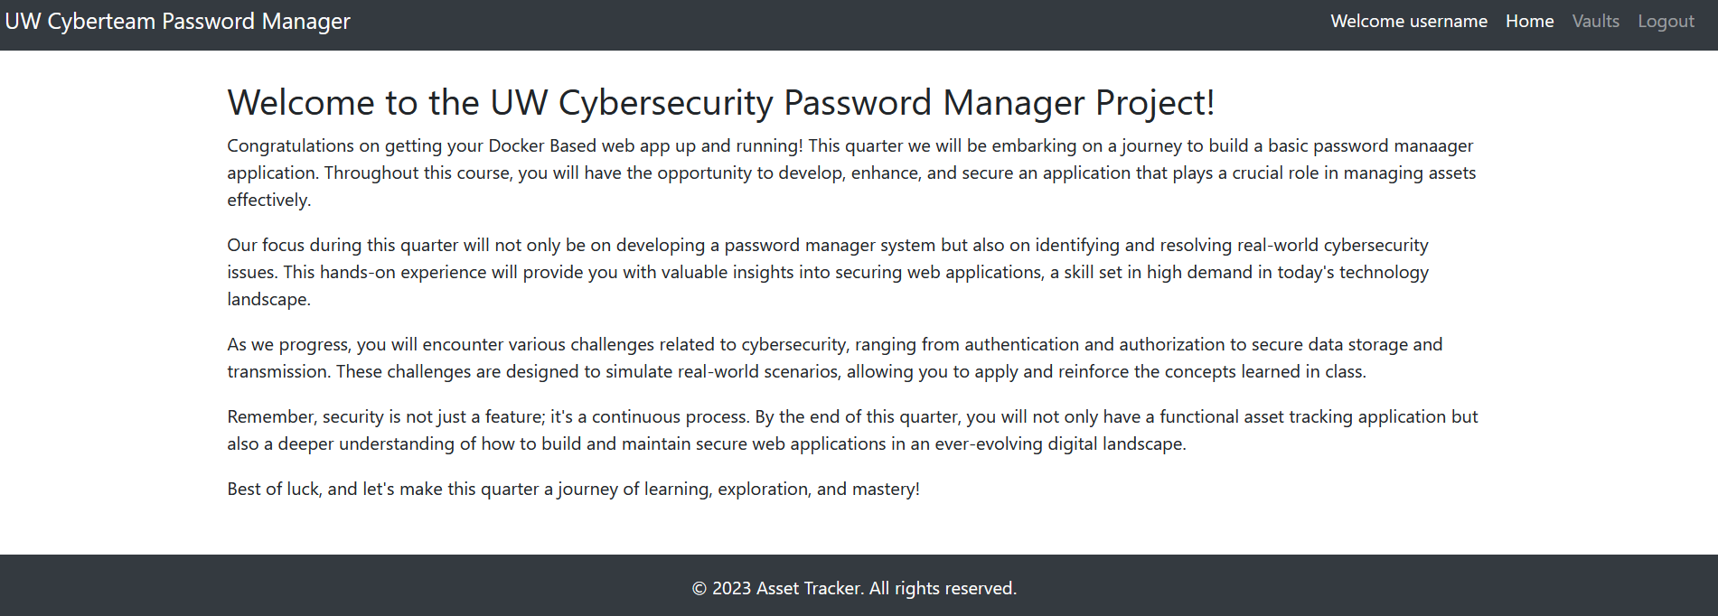
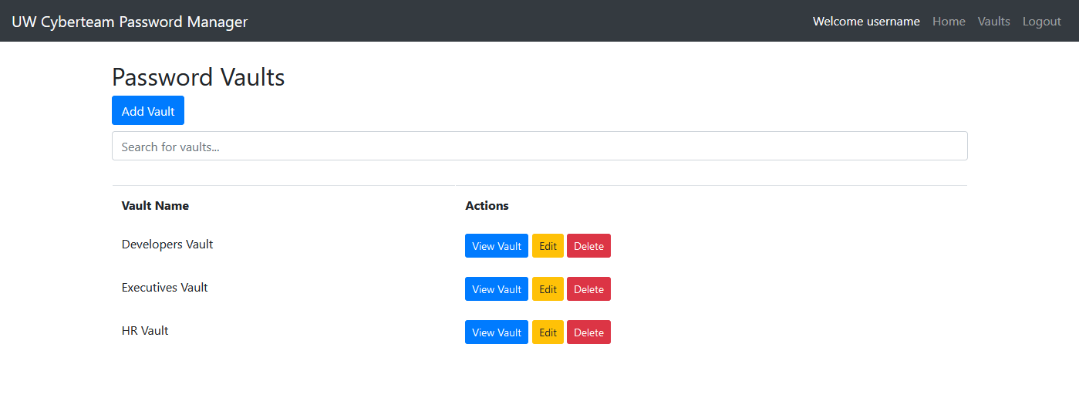
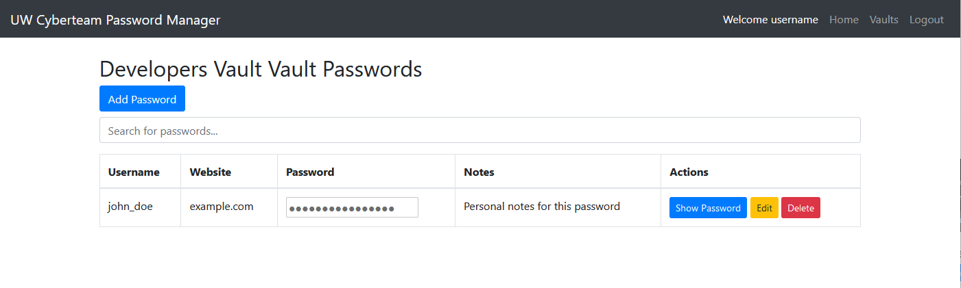
Notes:
Docker: platform for developing and deploying applications within containers
Containers: self-sufficient units capable of running an application and its dependencies isolated from the underlying operating system
Using docker allows u to develop and run applications (AKA secure passwordmanager) without affecting the end user’s operating machine.
Initial start of password manager
Which components were insecure
Nginx server, PHP server, MySQL database
Why components were insecure
Running on port 80: http://localhost:80
Port 80 = http (not-secure)

Slide 4
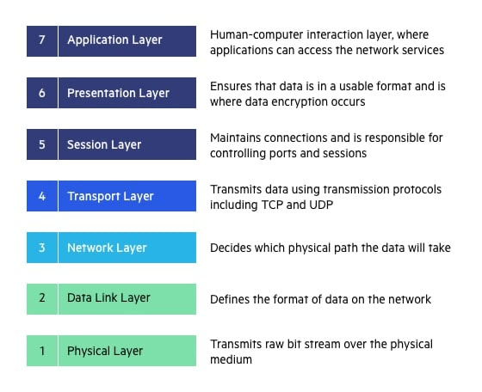
Notes:
In this presentation we’ll talk a lot about the application and the session layer
We followed along with the OSI model while securing our application to standardize how Password Manager communicates over the network.

Slide 5
Encryption
CIA: Confidentiality
OSI Model Layer: Application - 7
Port 80 → port 443
HTTP → HTTPS
How:
Notes:
HTTP: unsecured, unencrypted, sent in plaintext, susceptible to MITM attacks à allows potential attackers to look through packets
HTTPS: secured, encrypted, ensures integrity, provides authentication of the server.
CA: certificate Authority: establishes identity, assigns authority, secures confidential information
Using an insecure protocol and wanting to switch to a secure protocol through changing the port to 443 from 80 via Public Key Cryptography and PKI (a network that keeps track of valid certificates).
Important because it allows us to generate a key for symmetric encryption via keys created from asymmetric encryption. Asymmetric encryption allows the two parties to securely exchange data without having a previously shared key, however these algorithms are slow. Using asymmetric encryption to securely exchange a key for symmetric encryption we were able to leverage the speed of symmetric encryption.
TLS Handshake: user requests Password Manager’s certificate, password manager sends user the certificate with the public key, client verifies password manager certificate using a list of trusted CAs, the server is verified and the user generates a symmetric session key with Password Manager’s public key and sends it back to Password Manager server. This server is the only server that can decrypt the message being sent by the user by using its private key to retrieve the symmetric key.
Now we can rest assured that our packets are being encrypted and sent over a secure protocol instead of the previously unsecure HTTP.

Slide 6
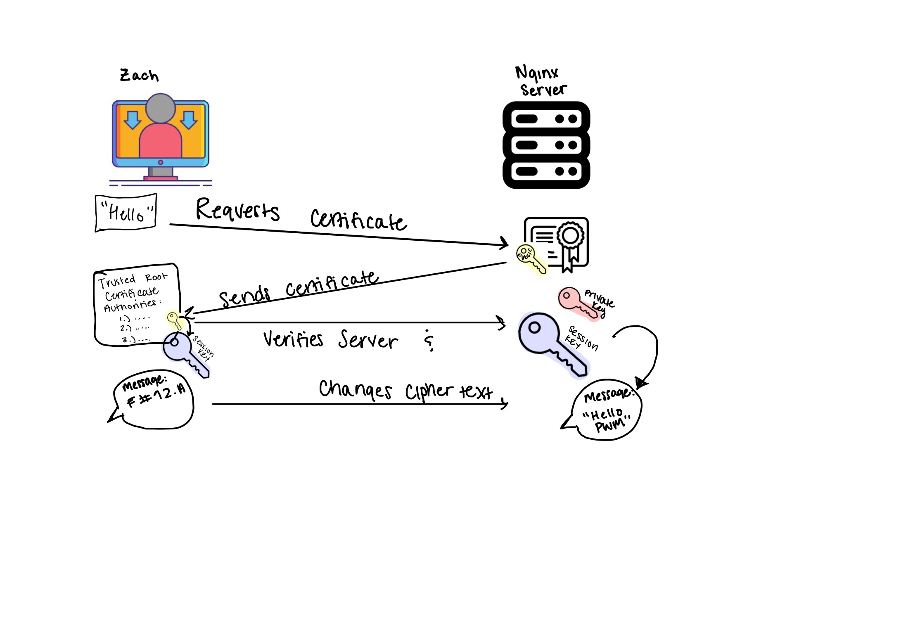
Public key encryption
TLS Handshake:
How:
Notes:
asymmetric encryption: Public Key Cryptography to exchange keys and create secured session
symmetric encryption is used after secured session is established. Same key is used for both encryption and decryption
TLS Handshake: user requests Password Manager’s certificate, password manager sends user the certificate with the public key, client verifies password manager certificate using a list of trusted CAs, the server is verified and the user generates a symmetric session key with Password Manager’s public key and sends it back to Password Manager server. This server is the only server that can decrypt the message being sent by the user by using its private key to retrieve the symmetric key.

Slide 7

Logging:
CIA: Integrity
OSI Model Layer: Application - 7
.env file
Loggly – customer token
Notes:
Logging protects the assets of our application because it provides a trail of documented events useful for threat detection, incident response, user activity monitoring, and analysis about our application.
We were primarily focused on tracking Application Account Information to monitor data about: logging in/out, account creation and other changes, number of login attempts, creating a vault, adding files to a vault, changing passwords, change in user access or use of privileged accounts.
We used loggly to send out logs for important events that occur. Once we created a loggly account, we were provided with a secret customer token that we then added to our .env file. This token allowed the logging system (loggly) to properly verify what logs are intended to be monitored and who to send the logging data back to. Ensuring the confidentiality of the password manager’s security..

Slide 8



Authentication
CIA: Confidentiality
OSI Model Layer: Session - 5
Stored on Nginx server = less vulnerable to client side attacks (XSS)
Notes:
Changed cookie to session ID
Confidentiality – ensures info is accessible to only those who are authorized to see it by verifying identity of users/devices before granting access to the system. Helps prevent unauthorized access and therefore protects the confidentiality of our password manager
Authentication: security practice of confirming that someone is who they claim to be (password and username – login)
Authentication: security practice of confirming that someone is who they claim to be (password and username – login)
We wanted to ensure that users are properly authenticated so we switched our cookies to Session ID. This ensures the confidentiality and integrity of data being transmitted from user to application.

Slide 9
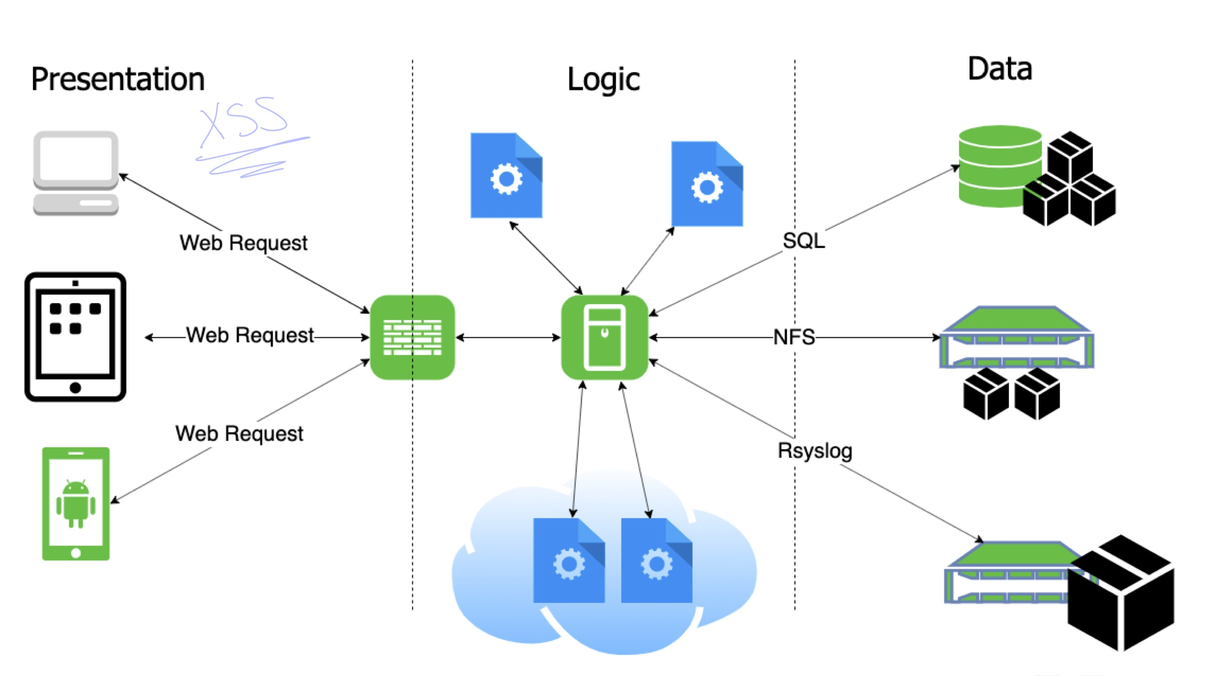
Session ID
Notes:
Presenation layer: user interacts with password manager application, users identify themselves by logging in
Logic layer: handles logic for authenticating users by verifying their credentials to ensure they are who they claim to be
Data layer: securely stores user credentials, roles, and permissions
The authentication of our web application can best be described by breaking it down through the three tier architecture: Presentation/Logic/Data:
The user submits their credentials in the presentation layer
Presentation layer is where the user submits their credentials.
Our web application is now more secured because it initially used cookies to store session information, exposing sensitive information because cookies are stored solely on the client side
After receiving the credentials, the Logic Layer verifies them against the stored information in the data layer. If the authentication is successful, then the logic layer generates a session ID for user’s session.
The Logic layer then sends the session ID back to the presentation layer where it is stored as a cookie in the user’s browser. Except now the data is stored securely on the server not just the session itself!
By storing the actual session data on the server, the sensitive information is less vulnerable to XSS attacks because the server has full control over session data and can invalidate sessions and enforce expirations of cookies.

Slide 10
Authorization
CIA: Confidentiality & Integrity
OSI Model Layer: Application - 7
User must be able to access only the information and resources that is necessary for its legitimate purpose
Principle of Least
Privilege
Role Based Access Controls (RBAC)
Access security based on person’s role within Password Manager: Viewer, Editor, Owner
Important Admin controls::
Changing Admin Privileges
Viewing vaults and user passwords
Ability to edit HTML or inject malicious code into server
Notes:
Authorization requires authentication, authentication doesn’t require authorization
Authorization: process of determining which level of access each user is granted
Update isSiteAdministrator and logout.php to use Session ID instead of a cookie
When it comes to ensuring only the correct people can access certain information in the Password Manager, access controls were key. They act as the bouncer at Finn’s checking everyone’s ID to make sure they are who they claim to be. This is important because it keeps potential attackers from sneaking around our application and mess with things they shouldn’t. Such as (explain “important admin controls” on slide):
While adding these access controls, we stuck to the Principle of Least Privilege to:
Help prevent unauthorized privilege escalation
Implemented through RBAC
Preserves confidentiality/integrity because it acts as the first line of prevention
Role Based Access Control
Granted permissions based on their roles:
Only allows users to access information they need to do, while preventing them from accessing additional information
The data layer ensures that access to data is granted according to the roles and permissions defined here:

Slide 11
RBAC
Users:
Viewer
Editors
Owners
Roles:
Need read-only access without ability to edit or modify data
Modify existing entries (limitations when it comes to sensitive user data such as viewing password vaults)
Manage users and roles
Permissions:
Create account, login, logout, see welcome page, see vaults (but not passwords)
Edit passwords, edit personal login information, create vaults, add files to vaults
View users, edit users, change passwords, delete users, view passwords,
Notes:
Data layer ensures that access to data is granted according to the roles and permissions defined here:

Slide 12
APPLICATION SECURITY: XSs and injection
CIA: Confidentiality & Integrity
OSI Model Layer: Application - 7
SQL Injection:
Stored XSS:
Notes:
Vulnerabilities we had from the start include SQL injection and Cross SIte Scripting
MySQL wasn’t parameterized and the query was dynamic, leaving password manager vulnerable to SQL injection. A dynamic query combines user input with the SQL command strings and allows potential attackers to manipulate the query structure.
As we saw when testing this vulnerability by injecting malicious script directly into the query through adding php files to our vaults
So we remediated SQL injection by using parameterized queries to set the logic before any inputs are inserted to prevent the logic from being modified.
Even though we remediated the SQL injection vulnerability, our application still stored unsanitized user input. Allowing attackers to embed malicious code into our stored data so that when other users/administrators view this data the malicious script will be executed on their browser.
We remediated the vulnerability to XSS by sanitizing the user inputs ensuring data is in plain text. Sanitizing to plain text effectively allowed us to remove any embedded scripts that could be executed on the users browser.

Slide 13

Hardening Bug Bounty:
CIA: Confidentiality
OSI Model Layer: Application - 7
Bug Bounty
How to continue to monitor and maintain security posture
Logging
Penetration Testing
Notes:
Hardening:
We used the process of hardening to secure our system further and reduce its surface of vulnerability. And we did this by:
Conducting a bug bounty program to identify vulnerabilities.
Where our administrator Zach Offered a reward (a good grade on our lab writeup) to ethical hackers (AKA our lab groups) to discover security vulnerabilities in the Password Manager
TALK ABOUT how we will continue to monitor and maintain security:
Whats still vulnerable:
There’s no Two Factor
Add a multifactor authentication to our application

Slide 14
Remediation
Hash
Bug Bounty: Passwords stored in plaintext
Remediation:
hash passwords before storing
Update
Bug Bounty: Outdated versions of PHP
Remediation:
add updated php script to docker
Change Permissions
Bug Bounty:
Improper permissions set in DockerPHP files
Remediation: change folder permissions from 777 to 744 and implement access controls
.env
Bug Bounty:
Hardcoded credentials for MySQL exposing us to unauthorized access
Remediation:
use variables for MySQL credentials in .env file

Slide 15
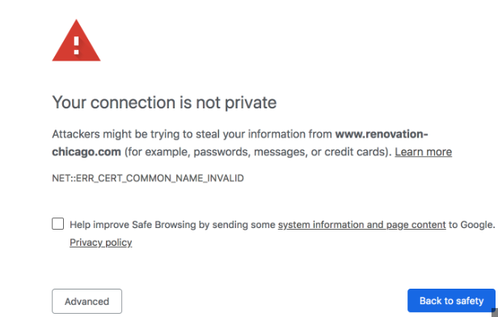
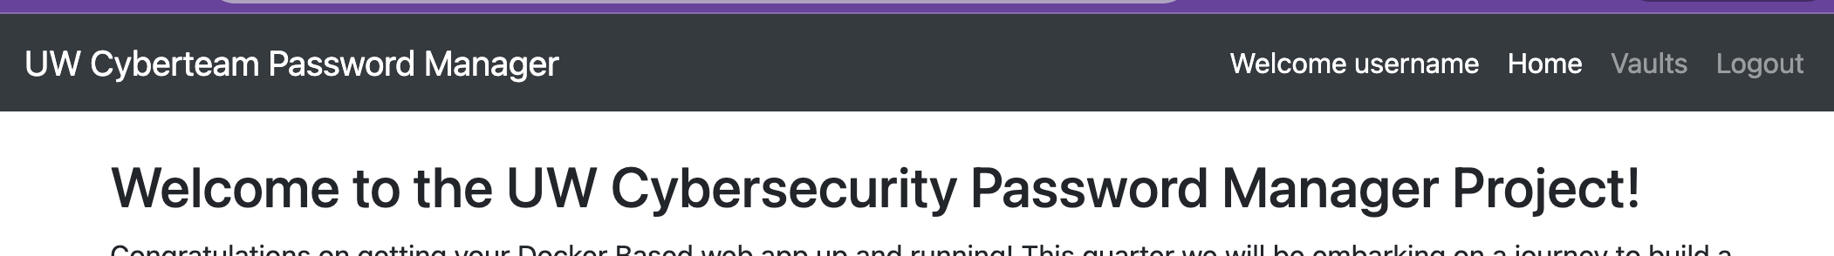
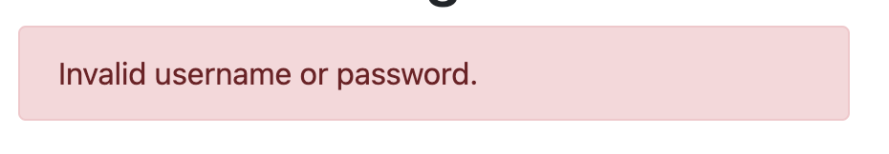
Test cases
System Test:
HTTPS testing:
Acceptance Test:
Positive Use Test:
Successful Login Test
Negative Use Test:
Invalid login Test
Notes:
Walk through Successful login test
This script simulates a user entering a valid username and password into login and password fields. The test then checks that after clicking the login button with the correct credentials that the user sees the welcome message and their username displayed on the top of the page
Walk through Unsuccessful login test
Intentionally gives the login page invalid credentials, and expects the application to display an error message. This test is checking to see that the Password Manager notifies the user of the incorrect login attempt.
HTTPS test
This test checks to ensure our application is running on port 443 instead of port 80. It does this by accessing the page through https://, if the HTTPS was set up incorrectly it would show “page not secure” error. Hence the test would fail. If the test passes, it means that the server is connected over port 443 and can securely transmit packets.
Thus verifying that our application is meeting our specific security requirements
*Use selenium ID: tool for automating web browsers to simulate how a user would interact with website

